Slide 1
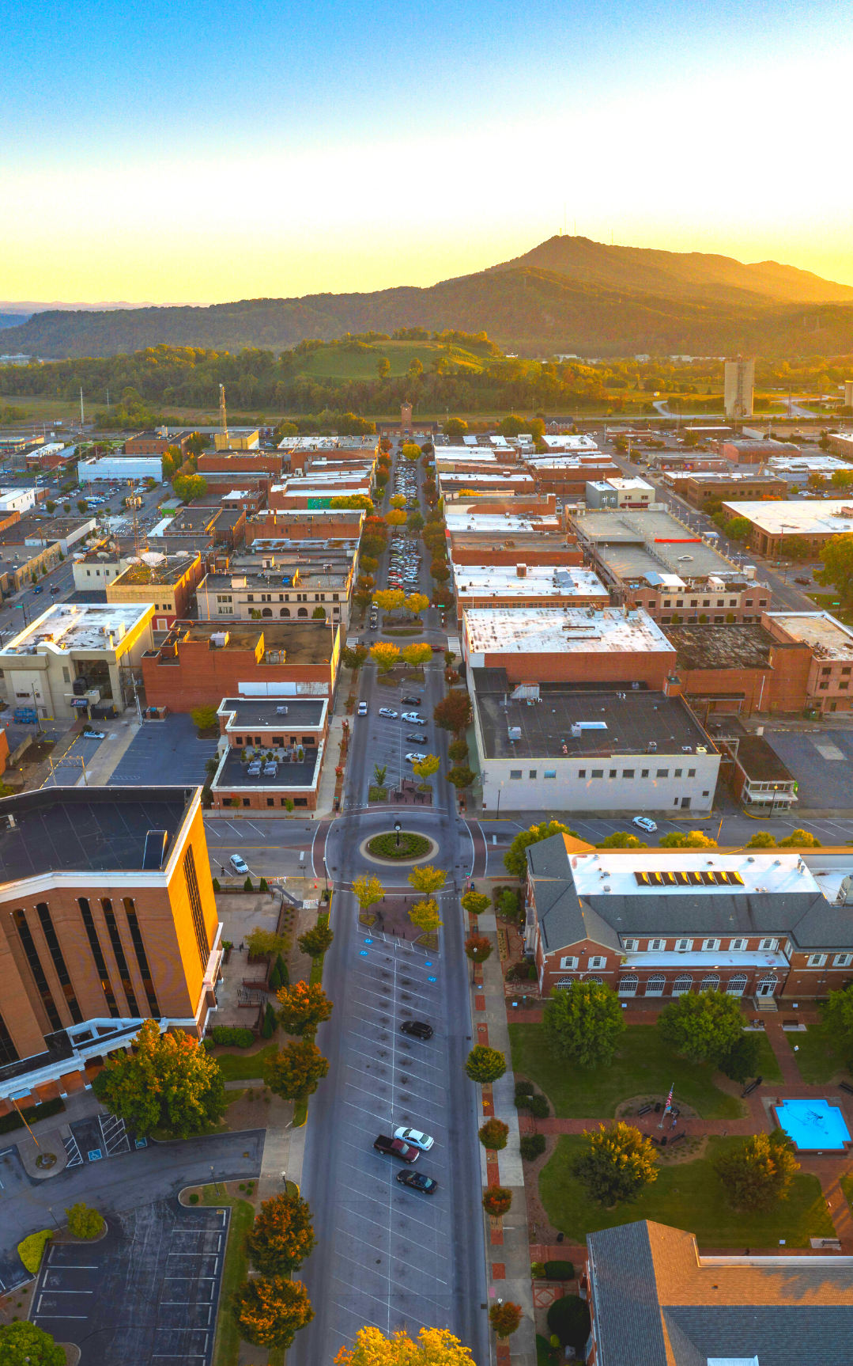
City of Kingsport 2026 Sub-recipient Workshop
04/02/2026
Michael Price
the city of kingsport

Slide 2

CDBG Overview
CDBG Sub-recipient Workshop
Purpose:
Community Development Block Grant (CDBG) funds are provided by the U.S. Department of Housing and Urban Development (HUD) in order to improve local communities by providing decent housing, improved infrastructure, public facilities and services, and improved economic opportunities.
Federal law requires community development grant funds to primarily benefit low and moderate-income persons or areas.

Slide 3
CDBG Overview
CDBG Sub-recipient Workshop
CDBG Objectives:
Benefit to low- and moderate- income (LMI) persons;
Aid in the prevention or elimination of slums or blight; and
Meet a need having a particular urgency (referred to as an urgent need). Where other funding does not exist.

Slide 4
Notice of Funding Availability
CDBG Sub-recipient Workshop
Estimated funding available:
2026 Allocation: Estimated $457,885.00
  Community Enrichment - $68,682.75 for public service projects
  Rehabilitation - $177,625.25 for emergency home repair projects
  Exact award has not been announced by HUD

Slide 5
Notice of Funding Availability
CDBG Sub-recipient Workshop
Scope of Work:
Under this program, CDBG funds may be used to provide services (including direct service labor, supplies, materials, facility maintenance, operation costs, and other costs).
The completed application must address one or more of the targeted public service needs and must serve primarily low to moderate-income persons in City of Kingsport.
Implementation Period: July 2026 – June 2027

Slide 6
Application:
CDBG Sub-recipient Workshop
Application
  The application itself is a measure of the applicant’s capacity.
  Follow instructions and submit all requested documentation.
Be innovative
  We’re looking for new and innovative projects
  If your project has been funded before - how can you increase your level of service
Don’t forget the Basics
  Complete ALL questions in the application (use N/A)
  Use the application checklist to verify all requested information has been provided

Slide 7
Eligible Activities include, but are not limited to:
CDBG Sub-recipient Workshop
Public Services:
Community Programs:
Senior Services
Services for Persons with Disabilities
Legal Services
Youth Services
Transportation Services
Substance Abuse Services
Services for victims of domestic violence
Crime Awareness/Prevention
Fair Housing Activities
Tenant/Landlord Counseling
Child Care Services
Health Services
Services for Abused and Neglected Children
Mental Health Services
Neighborhood Cleanups
Food Banks
Housing Counseling
Clearance and Demolition
Rehabilitation: Single-Unit Residential

Slide 8
Public Services:
CDBG Sub-recipient Workshop
The following Public services are not eligible under this category:
Political activities; §570.207(a)(3)
Ongoing grants or non-emergency payments to individuals for their food, clothing, rent, utilities, or other income payments. §570.207(b)(4)

Slide 9
Public Services:
CDBG Sub-recipient Workshop
Required Recording:
For each activity, the following types of documentation must be kept:
(1) Documentation showing that the activity is designed to be used exclusively by a segment of the population presumed by HUD to be L/M income persons (e.g., abused children); or
(2) Documentation describing how the nature and the location of the activity establishes that it will be used predominantly by L/M income persons; or
(3) Data showing the size and annual income of the family of each person receiving the benefit.
(4) Need to retain documents at least 5 years. Preferably 7 years.
(5) Documentation proving citizenship should be obtained.

Slide 10
Application:
CDBG Sub-recipient Workshop
Application Process:
Applicants must submit one scanned electronic copy (PDF required) of the application
Applications should be emailed to michaelprice@kingsporttn.gov by the application due date.
Applications that do not arrive at the Community Development office by the application deadline will not be considered.
Applicants should be prepared to present proposals to the Community Development Advisory Committee
Applications are due no later than, April 30, 2025 at 5 PM

Slide 11
Checklist:
CDBG Sub-recipient Workshop
Applicants should attach the following documentation:
  Detailed project budget
  List of Board of Directors
  Organizational chart
  List of Program and/or key Volunteer Staff; provide a description of role in organization and past work experience
  Official documentation attesting to your non-profit status (if applicable)
  Your organization’s most recently approved budget for program year 2025-2026
  Your Agencies EIN and UEI #’s
  Optional:
  List any letters of support or additional documentation supplied

Slide 12
Checklist:
CDBG Sub-recipient Workshop
If funded, applicants will be asked to provide additional information including but not limited to the following:
Copy of your organization’s Articles of Incorporation and Bylaws
Your organization’s most recent audit (if it has one)
Your organization’s most recent 990 (if applicable)
Your organization’s most current financial statements

Slide 13
Things to know:
CDBG Sub-recipient Workshop
Funds are distributed by reimbursement only.
Please do not begin ANY work until your contract has been signed and your scope of work approved
Provide reports quarterly as required for compliance.
Submit Request for expended funds quarterly as required for reimbursement. It is acceptable to draw funds monthly.
Funds are to be expended within the 12 month contract period.
All funded non-profits must submit quarterly reports and a year end report.

Slide 14
Things to know:
CDBG Sub-recipient Workshop
You must report quarterly - funds will be held if reports are past due!
Reporting Timeline:
July - September – Report Due October 15th
October - December– Report Due January 15th
January - March – Report Due April 15th
April – June – Report Due June 15th
Annual Reports & Summary Narrative Due July 30th

Slide 15
Things to know:
CDBG Sub-recipient Workshop
We are ALL subject to Federal Rules & Regulations
2CFR Part 200
  UNIFORM ADMINISTRATIVE REQUIREMENTS, COST PRINCIPLES, AND AUDIT REQUIREMENTS FOR FEDERAL AWARDS
24 CFR Part 570
  CDBG Program Regulations

Slide 16
Things to know:
CDBG Sub-recipient Workshop
What is the purpose of a sub-recipient monitoring?
  It’s a HUD Requirement.
  Sub-recipient monitoring is a key part of the CDBG program. The City bears the responsibility to ensure that Sub-recipients follow federal regulations, conduct the projects / services and accomplish the goals as established in the sub-recipient agreement.
  Monitoring also provides opportunities for both the City and the Sub-recipients to identify issues that may hinder efforts to successfully accomplish the goals and address these issues in a timely manner.
  Monitoring is also used by the City as a way to identify sub-recipient needs and provide technical assistance if necessary.

Slide 17
Selection and Evaluation Process:
CDBG Sub-recipient Workshop
The selection process of applications for funding will include a staff and Community Development Advisory Committee evaluation and recommendation for an award based on the following criteria:
Criteria:
Alignment with 5 year Consolidated Plan
Public Benefit
Organizational Capacity
Collaboration/Leverage
Clarity and Completion
Financial Feasibility
Discretionary Assessment
10 points
30 points
5 points
20 points
10 points
20 points
5 points

Slide 18
Selection and Evaluation Process:
CDBG Sub-recipient Workshop
Does your agency have a plan?
Are the goals clearly defined?
Is the need adequately described?
Will the project address service gaps in the community?
Will the project improve the quality of life?
Does the applicant indicate outcomes?
Does the applicant define goals?
Is the process adequately described?
Outcomes and success measureable?
What National Objective is being met?
Any efforts to coordinate and collaborate with other agencies?
Service area identified (Kingsport City Limits)
Any special attention to target population
Prior work experience with CDBG and other grant funds
Adequate staff
Key staff experience/capability
Agency capacity

Slide 19
Selection and Evaluation Processes:
CDBG Sub-recipient Workshop
Grant applications go through a four step approval process:
  Staff Review - (Non-compliant organizations are identified.)
  Community Development Advisory Committee reviews the requests and makes funding recommendations to Board of Mayor and Alderman.
  City Board of Mayor and Aldermen reviews the Committee’s recommendation and may adopt or change the funding allocations.
  The BMA’s funding decision is then sent to HUD as part of the City of Kingsport Annual Action Plan for HUD approval or denial.

Slide 20
Selection and Evaluation Processes:
CDBG Sub-recipient Workshop
Contractual Requirements
  Applicants must demonstrate that they are a nonprofit organization or a governmental agency.
  After an application is approved for funding, an agreement will be prepared and sent by the City to the identified by the applicant as the authorized official for signature.
  Each agency receiving CDBG funding from the City is required to certify that it will conduct its business in compliance with the non-discrimination requirements of the City, State and Federal governments, as applicable. Equal Opportunity in Employment policies will be required.
  In the event of non-compliance, the agreement may be terminated or suspended.
  All recipients will be required to comply with the federal government’s audit requirements as described in 2 CFR 200 Uniform Administrative Requirements, Cost Principles, and Audit Requirements for Federal Awards.
  Proposed project must meet one of the CDBG National Objectives

Slide 21
Funding Request:
CDBG Sub-recipient Workshop
Funds are limited so be realistic in your request.
Is it a project you can complete within 12 months?
Do you have other funds available?
CDBG funds are “gap” funds.
CDBG funding cannot nor is it intended to fund a project and/or program 100% - funds are not meant to sustain your organization

Slide 22
Questions?
CDBG Sub-recipient Workshop
Contact Information:
Michael Price
415 Broad St, 2nd Floor
(423)224-2877
Michaelprice@KingsportTn.gov

